Slide 1
Medical Visual Question Answering
Guided by:
Dr. Saidalavi Kalady Dr. S. Sheerazuddin
Group 42
Nidhin Mohan- B180948CS Shaaheen A M- B181134CS
Abhinav B Naik- B170297CS

Slide 2
Introduction

Slide 3
Medical Visual Question Answering(Med-VQA)
Med-VQA is a subtask of VQA, where we perform VQA on medical images. It has a wide variety of uses especially in the field of radiology and also in the diagnosis of tumours.
For our project we had trained our model using the data available in the SLAKE[12] dataset, which had 642 images and 14,028 question-answer pairs.
The existing Medical VQA models present in the papers we reviewed had on average about 50-70% accuracies.

Slide 4
Problem Statement

Slide 5
To understand a given medical image, a question relevant to the image and to correctly predict the answer to the question based on the information present in the image, using deep learning techniques.

Slide 6
Literature Survey

Slide 7
Paper | Methodology | Results
[3] AIML at VQA-Med 2020: Knowledge Inference via a Skeleton-based Sentence Mapping | Used a knowledge inference methodology called Skeleton Based Sentence Mapping. | Accuracy–0.496 BLEU[4]–0.542
[5] Medical Visual Question Answering via Conditional Reasoning | Used Question Conditioned Reasoning module and Task Conditioned Reasoning module to classify questions. | Accuracy-60%
[6] Visual Question Answering in the medical domain based on deep learning approaches: A comprehensive study | The question was classified into four types: organ system, plane, modality and abnormality. | Organ system-75.2% Plane-77.6% Modality-72% Abnormality-18.4%

Slide 8
Paper | Methodology | Results
[7] The Inception Team at VQA-Med 2020: Pretrained VGG with Data Augmentation for Medical VQA and VQG | Questions were classified into either closed or open ended type and the answer was predicted accordingly. | Accuracy- 0.48, BLEU-0.511
[8] A Sequence- to-Sequence Model Approach for ImageCLEF 2018 Medical Domain Visual Question Answering | Used a deep neural network with CNNs to obtain image embeddings. | BLEU score- 0.188. WBSS- 0.209.
[9] Hierarchical deep multi-modal network for medical visual question answering | An SVM-based question segregation module separates the learning path based on open or closed-ended questions. | BLEU-0.0365. WBSS-0.173.

Slide 9
Paper | Methodology | Results
[10] CGMVQA: A New Classification and Generative Model for Medical Visual Question Answering | Questions were classified into five categories: Image features obtained using RestNet152. | Accuracy-0.64. BLEU-0.659. WBSS-0.678.
[11] MMBERT: Multimodal BERT Pretraining for Improved Medical VQA | They used a Multimodal BERT model, pretrained on a VQA Dataset. They used Resnet-152 for Image feature extraction. | Accuracy-0.672. BLEU-0.69.

Slide 10
Proposed Work

Slide 11
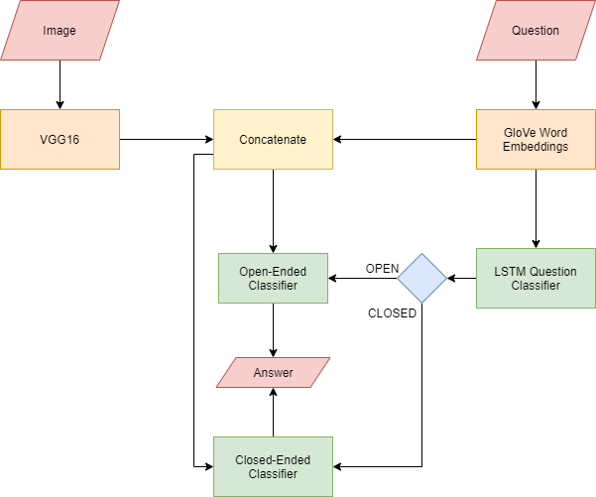
Proposed Medical VQA Framework

Slide 12
Obtaining the Necessary Data
The SLAKE Dataset is used for training our Medical VQA model.
It contains 9,835 training examples and 2,094 testing examples. Each example is a question-answer pair
Question-answers are divided into open-ended and closed-ended questions, with the dataset containing both English and Chinese questions
Questions are of two base types: vqa and kvqa

Slide 13
The Questions are four types based on their answers:
Open-ended single answer
Open-ended multiple answer
Multiple Choice
Closed-ended Yes/No
For our framework, we used the English open-ended single answer and closed-ended yes/no questions
Training set -> 3949 questions
Test set -> 831 questions
Validation set -> 814 questions

Slide 14
Image Feature Extraction
Model used- VGG16[14] pretrained on ImageNet[16] database
Input- 224x224x3 dimensional images
Output- 7x7x512 feature vector without the final four layers of VGG16
This feature vector is flattened into a 1x25088 array
Each image feature is combined into a single array with rows being the flattened image feature

Slide 15
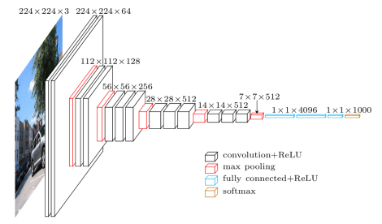
VGG16 model architecture. For our project, we have removed the final three fully connected layers and the softmax layer since we only want the image features.

Slide 16
Question Feature Extraction
Weights used- GloVe word embeddings.
Input- question as a string.
Question -tokenizer-> [1, 5, 4, 17, 95] -padding-> [1, 5, 4, 17, 95, 0, 0, 0, 0, 0, 0, 0, 0, 0, 0, 0]
The padded sequence is passed through an Embedding layer which assigns GloVe word embedding weights to each word(1x100 vector) and then flattened.
Output- 1x1600 dimensional vector.

Slide 17
Question Classification
Model used- Sequential model with a Bi-LSTM layer of 50 units and a Dropout layer.
Input- 1x1600 dimensional question vector.
Output- a float value between 0 and 1.
The question classification model classifies the question vector into yes/no or open-ended questions.
The result of this question classifier determines whether to use open ended or yes/no answer classifier to predict the answers.

Slide 18
Feature Fusion
Inputs- 1x25088 dimensional image vector and 1x1600 dimensional question vector.
Output- 1x26688 dimensional fused vector.
Have performed the simplest feature fusion method, that is concatenating the two features together.
For each question, the corresponding image feature vector is retrieved and concatenated to obtain a 1x26688
feature vector which is then passed to the corresponding classification model.

Slide 19
Classification
Two separate classifiers for obtaining the final answers :
[1] Softmax classifier : classifies open-ended questions into 1 of 124 answer classes.
[2] Sigmoid classifier : classifies closed-ended questions into either Yes or No.
Image-question fused vector is passed to the corresponding classifier based on the output of the question classifier.

Slide 20
Experimental Results

Slide 21
Question Classifier gave an accuracy of 100%.
Open ended image-question classifier model gave an accuracy of 62.91% (515 open-ended image-question pairs).
Closed ended image-question classifier model gave an accuracy of 61.08% (316 closed-ended image-question pairs).

Slide 22
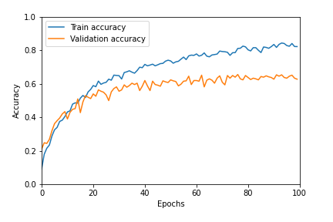
Training and Validation Accuracies against epochs for Open-Ended Question Answer Classifier

Slide 23
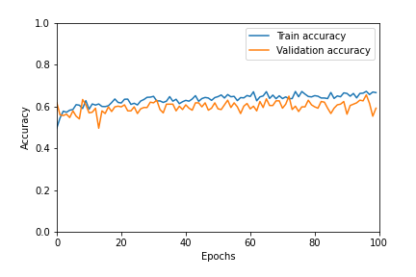
Training and Validation Accuracies against epochs for Closed-Ended Question Answer Classifier

Slide 24
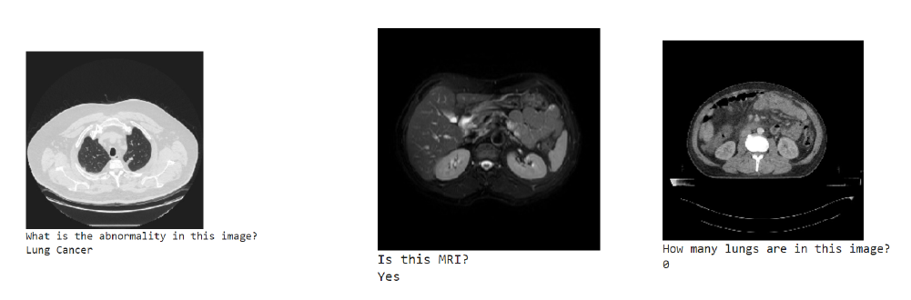
Some examples when manual testing that gave correct answers

Slide 25
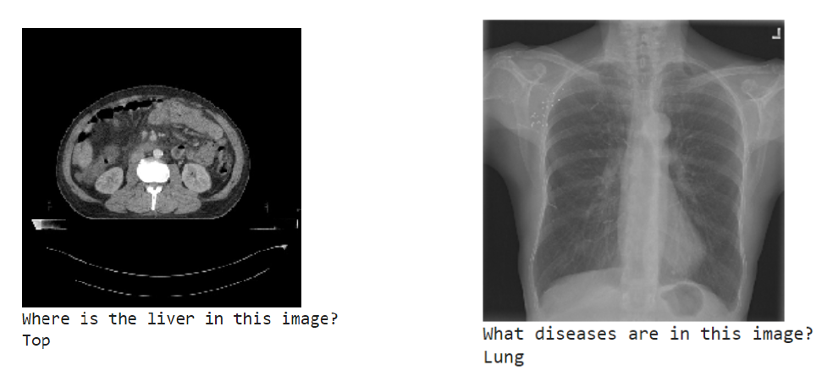
Some examples when manual testing that gave incorrect answers

Slide 26
Conclusion

Slide 27
Model has given good accuracies on the training, testing and validation datasets.
Questions could be segregated based on the content and appropriate information could be retrieved from the images to answer the questions.
Use of better feature fusion methods can improve the accuracy of the model.

Slide 28
References

Slide 29
[1] Jeffrey Pennington, Richard Socher and Christopher D. Manning.
”GloVe: Global Vectors for Word Representation”.
[2] Jin-Hwa Kim, Jaehyun Jun and Byoung-Tak Zhang. ”Bilinear Attention
Networks”.
[3] Zhibin Liao, Qi Wu, Chunhua Shen, Anton van den Hengel and Johan W. Verjans. “AIML at VQA-Med 2020: Knowledge Inference via a
Skeleton-based Sentence Mapping Approach for Medical Domain Visual Question Answering.”
[4] Kishore Papineni, Salim Roukos, Todd Ward and Wei-Jing Zhu. ”BLEU:
a Method for Automatic Evaluation of Machine Translation”.
[5] Li-Ming Zhan, Bo Liu, Lu Fan, Jiaxin Chen, and Xiao-Ming Wu. 2020.
Medical Visual Question Answering via Conditional Reasoning.

Slide 30
[6] Aisha Al-Sadi, Mahmoud Al-Ayyoub, Yaser Jararweh, and Fumie
Costen, “Visual question answering in the medical domain based on
deep learning approaches: A comprehensive study”
[7] Aisha Al-Sadi, Hana AL-Theiabat, Mahmoud Al-Ayyoub. (2020). The
Inception Team at VQA-Med 2020: Pretrained VGG with Data Augmentation for Medical VQA and VQG.
[8] R. Ambati and C. Reddy Dudyala, ”A Sequence-to-Sequence Model
Approach for ImageCLEF 2018 Medical Domain Visual Question Answering”.
[9] Deepak Gupta, Swati Suman, Asif Ekbal. (2020). Hierarchical Deep
Multi-modal Network for Medical Visual Question Answering.
[10] F. Ren and Y. Zhou, ”CGMVQA: A New Classification and Generative
Model for Medical Visual Question Answering”.

Slide 31
[11] Y. Khare, V. Bagal, M. Mathew, A. Devi, U. D. Priyakumar
and C. Jawahar, ”MMBERT: Multimodal BERT Pretraining for
Improved Medical VQA,”.
[12] Bo Liu, Li-Ming Zhan, Li Xu, Lin Ma, Yan Yang, Xiao-Ming Wu.
”SLAKE: A Semantically-Labelled Knowledge-Enhanced Dataset For
Medical Visual Question Answering”.
[13] Chelsea Finn, Pieter Abbeel, Sergey Levine. ”Model-Agnostic
Meta-Learning for Fast Adaptation of Deep Networks”.
[14] Karen Simonyan, Andrew Zisserman. ”Very Deep Convolutional Networks for Large-Scale Image Recognition”.
[15] Tuong Do, Binh X. Nguyen, Erman Tjiputra, Minh Tran, Quang D.
Tran, Anh Nguyen. ”Multiple Meta-model Quantifying for Medical Visual Question Answering”.
[16] J. Deng, W. Dong, R. Socher, L. -J. Li, Kai Li and Li Fei-Fei,
”ImageNet: A large-scale hierarchical image database”.

Slide 32
Thank You

